Slide 1

Adidas Sales Performance Analysis
Prepared by: Oxygenius’ Consults Ltd.
22nd June, 2026.

Slide 2
Executive Summary
Adidas generated $120M in revenue, sold over 2M units, and achieved $33M in operating profit with a 27.63% profit margin.
Men's Street Footwear is the largest revenue-generating product.
West Gear is the top retailer by revenue.
The West Region generated the highest revenue.
In-store sales produced the highest profit margin.
Online sales generated the highest revenue but the lowest profitability.
Revenue grew significantly from 2020 to 2021, indicating strong market expansion.

Slide 3
Business Objectives
The primary goal of this analysis is to evaluate Adidas' sales performance across products, retailers, regions, and sales channels enabling Adidas management to make data-driven decisions that improve operational efficiency, maximize profitability, and support sustainable business growth.
Revenue & Growth
What are the key drivers of Adidas' revenue and business growth?
Product Performance
Which product categories contribute the most to revenue and profitability?
Retailer Performance
Which retail partners generate the highest sales and profit for the business?
Regional Analysis
Which regions represent Adidas' strongest and weakest markets?
Sales Channel Performance
Which sales channels (Online, In-Store, Outlet) delivered the best performance and profitability?
Profitability Analysis
What factors are driving or limiting profit margins across the business?
Trend Analysis
What sales trends and seasonal patterns can be leveraged for future growth?
Strategic Opportunities
Where should Adidas focus investments to maximize revenue, profitability, and market expansion?

Slide 4
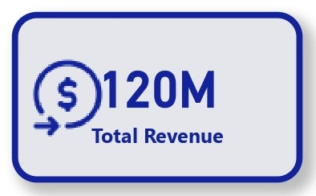
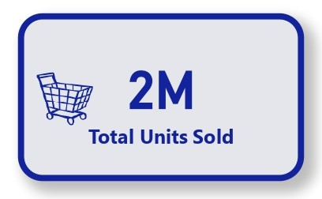
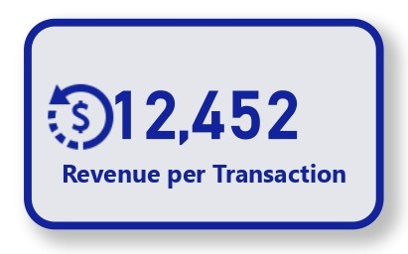
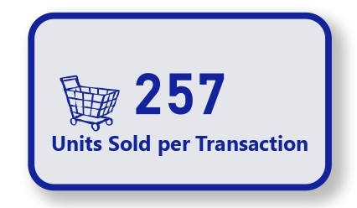
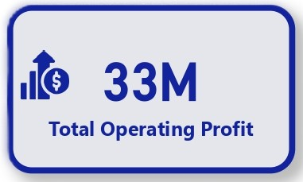
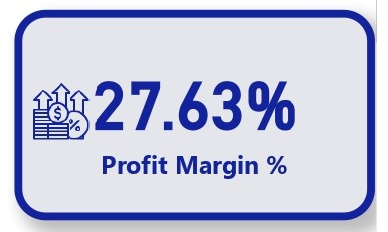
KPI Overview

Slide 5
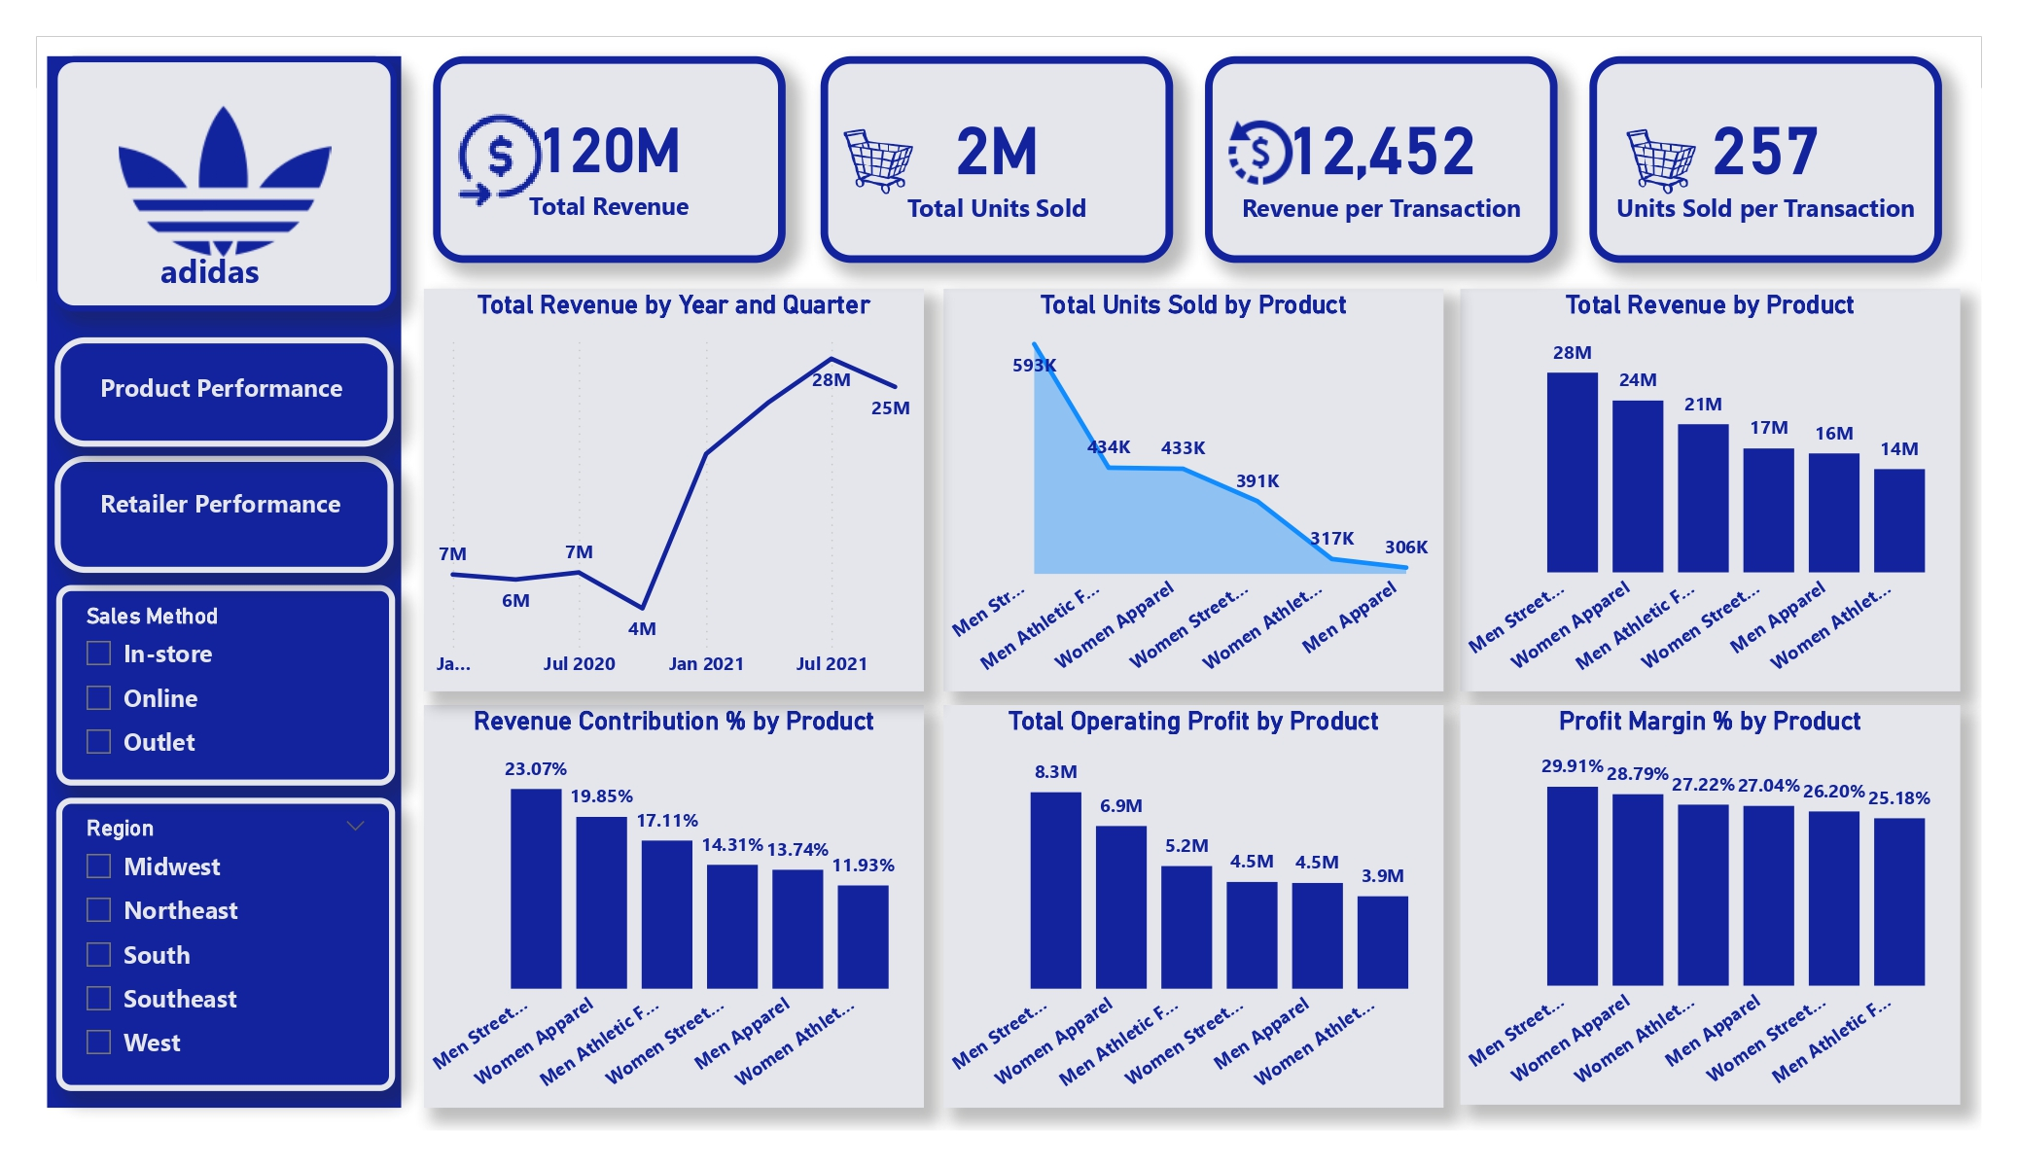
Product Performance Analysis

Slide 6
Insights
Men's Street Footwear generated 23.1% of total company revenue, making it Adidas' strongest product category.
The top three product categories(Men's Street Footwear, Women Apparel and Men Athletic Footwear) account for approximately 60% of total revenue, indicating revenue concentration around a few core product lines.
Women's Athletic Footwear contributes the least revenue and presents an opportunity for targeted marketing campaigns.
Men's Street Footwear is both the Highest revenue and Highest profit-generating product

Slide 7
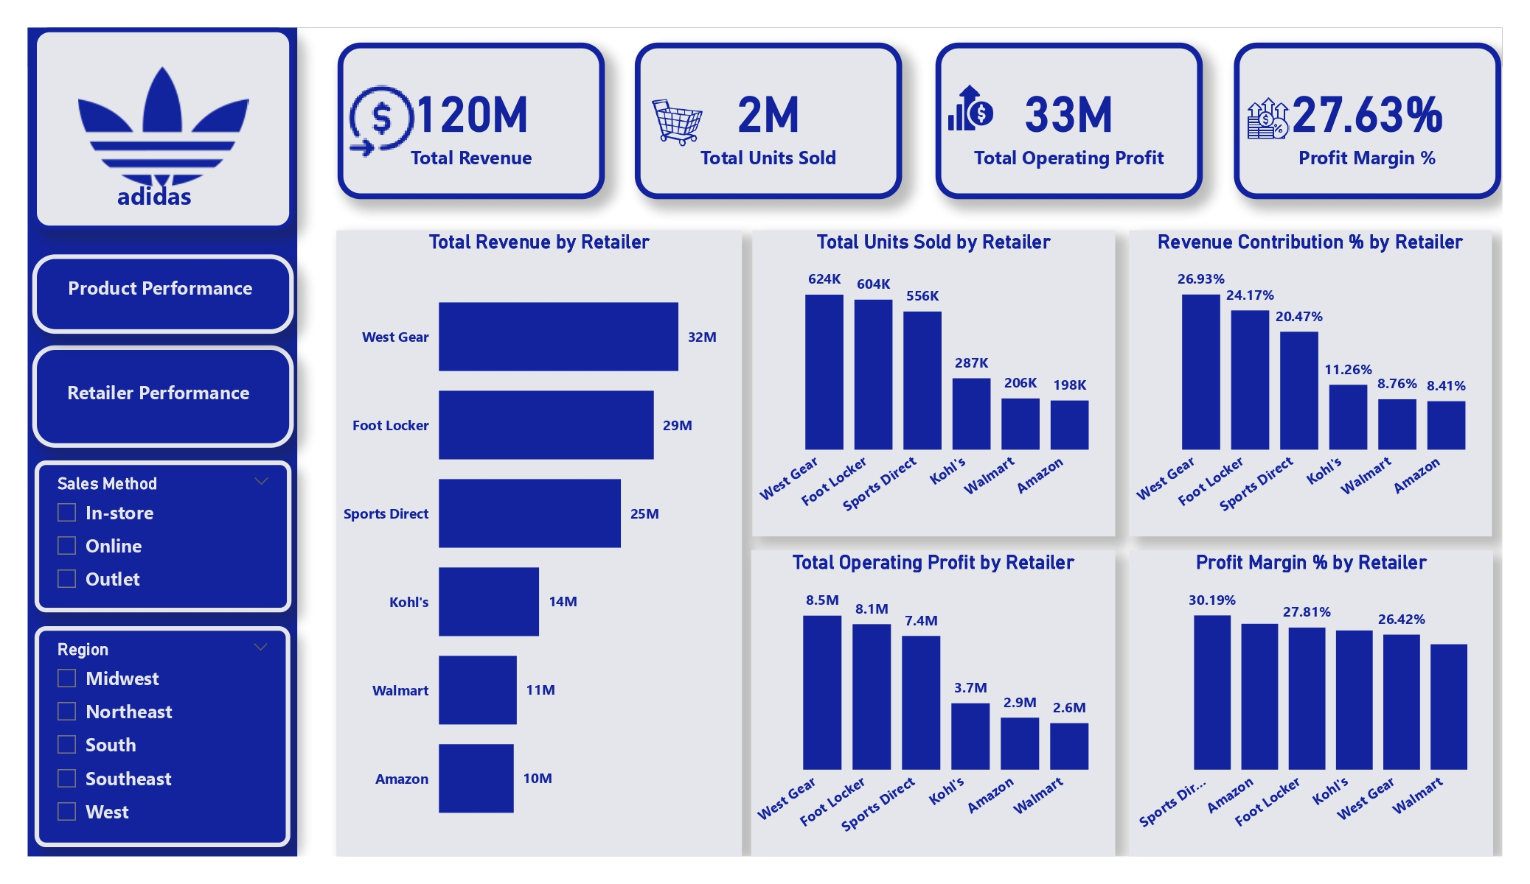
Retailer Performance Analysis

Slide 8
Insights
West Gear contributes approximately 27% of total revenue, making it Adidas' largest retail partner.
West Gear and Foot Locker together contribute over 50% of total sales revenue, creating retailer concentration risk.
Although West Gear generates the highest revenue, Sports Direct is the most profitable retailer.

Slide 9
Regional Performance Insights
The West region contributes over 30% of company revenue, making it Adidas' most important market.
The Midwest region generates the lowest revenue but achieves the highest profit margin.
The West region is Adidas' largest market but also its least efficient region in terms of profitability.

Slide 10
Sales Method Performance Insights
Online sales generate the highest revenue and account for approximately 37.5% of total sales.
Although Online sales generate the highest revenue, they produce the lowest profit margin.
In-store sales generate the strongest profitability despite lower revenue.
New York and California remain Adidas' most valuable state markets and should remain priority investment locations.

Slide 11
Trend Analysis Insights
Revenue increased by approximately 297% from 2020 to 2021, indicating exceptional growth.
Revenue showed a steady upward trend throughout 2021, with each quarter outperforming the corresponding periods in 2020.
Q3 2021 was the strongest quarter, generating over $28M in revenue.

Slide 12
Strategic Recommendations
Expand High-Performing Product Lines: Focus investment on Men's Street Footwear , Women's Apparel and Men's Athletic Footwear.
Improve Online Profitability: reduce excessive discounts, Logistics costs while optimizing pricing.
Strengthen Retail Partnerships: prioritize West Gear, Foot Locker, Sports Direct through joint marketing initiatives.
Replicate Midwest Efficiency: The Midwest achieves the highest profit margin. Identify best practices and apply them to other regions.
Increase Focus on High-Growth Markets: Expand investment in: New York, California, Florida and Texas.
Leverage Seasonal Trends: Use Q3 performance patterns to improve forecasting, inventory planning, and promotional scheduling.

Slide 13
Thank You for Listening.

